Slide 1
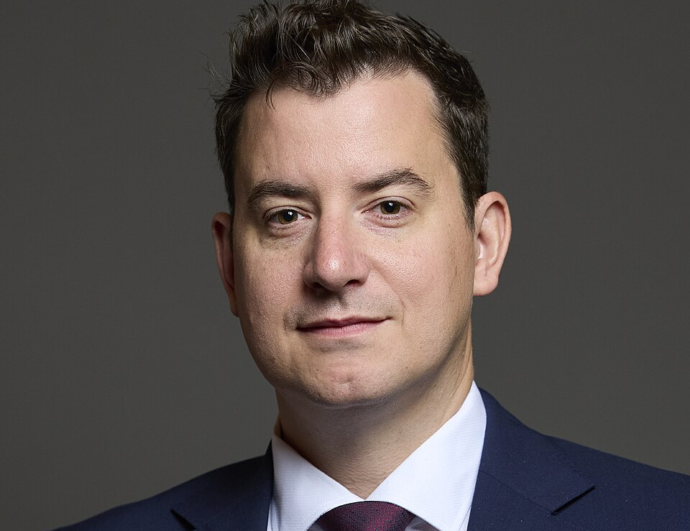



From Civil Engineering to Parliament:
Shaping the UK’s Infrastructure Future
School of Architecture, Building and Civil Engineering
ALUMNI GUEST TALK & NETWORKING EVENT
Guest speaker Mike Reader
Member of Parliament, Chair of the APPG on Infrastructure,
Labour Party Champion for Construction
16 April 2026 | 11:00 – 13:00 GMT
11:00 - 12:00 Talk + Q&A
12:00 - 13:00 Networking + refreshments
RT037 - Sir Frank Gibb
Book your place now

